Slide 1

Unit-4
Android Programming
Intents and Broadcast Receivers
Activity Lifecycle, Introducing Intents :( Implicit and Explicit Intents), Creating Intent Filters and Broadcast Receivers, Android service, Life cycle of Android service, Multithreading.
KLE Society’s College of BCA RLSI Belagavi

Slide 2
Intents in Android
Have you ever wondered how a new Activity opens when we click on some button, suppose the settings button to show the Settings screen in any app?
How does the app opens up when we click on its notification?
How do we get Low battery alert in our mobile?
All these things are possible because of Intent in Android.
An intent is to perform an action on the screen. It is mostly used to start activity, send broadcast receiver,start services and send message between two activities
KLE Society’s College of BCA RLSI Belagavi

Slide 3
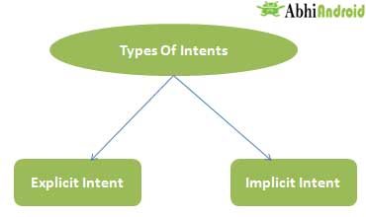
Android intents are mainly used to:
Start the service
Launch an activity
Display a web page
Display a list of contacts
Broadcast a message
Dial a phone call etc.
Intent are of two types:
KLE Society’s College of BCA RLSI Belagavi

Slide 4
Explicit Intent:
Explicit Intents are used to connect the application internally.
In Explicit we use the name of component which will be affected by Intent. For Example: If we know class name then we can navigate the app from One Activity to another activity using Intent. In the similar way we can start a service to download a file in background process.
Explicit Intent work internally within an application to perform navigation and data transfer. The below given code snippet will help you understand the concept of Explicit Intents
Intent intent = new Intent(getApplicationContext(), SecondActivity.class);
startActivity(intent);
KLE Society’s College of BCA RLSI Belagavi

Slide 5
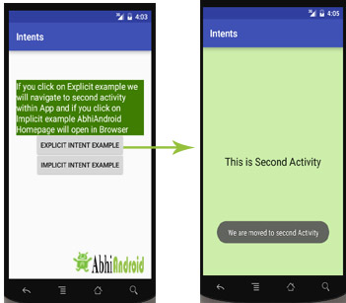
Here SecondActivity is the JAVA class name where the activity will now be navigated.
KLE Society’s College of BCA RLSI Belagavi

Slide 6
Implicit Intent:
In Implicit Intents we do need to specify the name of the component. We just specify the Action which has to be performed and further this action is handled by the component of another application.
The basic example of implicit Intent is to open any web page
Let’s take an example to understand Implicit Intents more clearly. We have to open a website using intent in your application. See the code snippet given below
Intent intentObj = new Intent(Intent.ACTION_VIEW);
intentObj.setData(Uri.parse("https://www.abhiandroid.com"));
startActivity(intentObj);
KLE Society’s College of BCA RLSI Belagavi

Slide 7
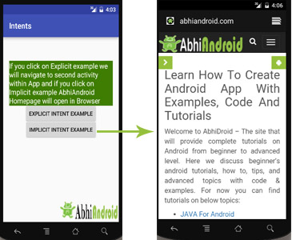
Unlike Explicit Intent you do not use any class name to pass through Intent(). In this example we has just specified an action. Now when we will run this code then Android will automatically start your web browser and it will open AbhiAndroid home page.
KLE Society’s College of BCA RLSI Belagavi

Slide 8
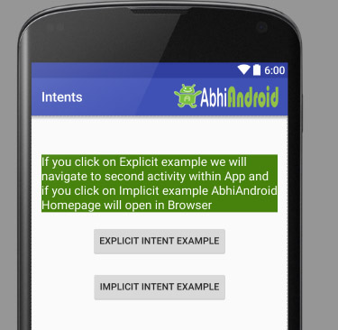
Intent Example In Android:
Let’s implement Intent for a very basic use. In the below example we will Navigate from one Activity to another and open a web homepage of AbhiAndroid using Intent.
The example will show you both implicit and explicit Intent together. Below is the final output:
KLE Society’s College of BCA RLSI Belagavi

Slide 9
Step 1: Let’s design the UI of activity_main.xml:
<RelativeLayout xmlns:android="http://schemas.android.com/apk/res/android"
xmlns:tools="http://schemas.android.com/tools" android:layout_width="match_parent"
android:layout_height="match_parent" android:paddingLeft="@dimen/activity_horizontal_margin"
android:paddingRight="@dimen/activity_horizontal_margin"
android:paddingTop="@dimen/activity_vertical_margin"
android:paddingBottom="@dimen/activity_vertical_margin" tools:context=".MainActivity">
<TextView
android:layout_width="wrap_content"
android:layout_height="wrap_content"
android:textAppearance="?android:attr/textAppearanceMedium"
android:text="If you click on Explicit example we will navigate to second activity
within App and if you click on Implicit example AbhiAndroid Homepage will open in Browser"
android:id="@+id/textView2"
android:clickable="false"
android:layout_alignParentTop="true"
android:layout_alignParentStart="true"
android:layout_marginTop="42dp"
android:background="#3e7d02"
android:textColor="#ffffff" />
<Button
android:layout_width="wrap_content"
android:layout_height="wrap_content"
android:text="Explicit Intent Example"
android:id="@+id/explicit_Intent"
android:layout_alignParentTop="true"
android:layout_centerHorizontal="true"
android:layout_marginTop="147dp" />
<Button
android:layout_width="wrap_content"
android:layout_height="wrap_content"
android:text="Implicit Intent Example"
android:id="@+id/implicit_Intent"
android:layout_centerVertical="true"
android:layout_centerHorizontal="true" />
</RelativeLayout>
KLE Society’s College of BCA RLSI Belagavi

Slide 10
Step 2: Design the UI of second activity activity_second.xml
<?xml version="1.0" encoding="utf-8"?>
<RelativeLayout xmlns:android="http://schemas.android.com/apk/res/android"
xmlns:tools="http://schemas.android.com/tools" android:layout_width="match_parent"
android:layout_height="match_parent" android:paddingLeft="@dimen/activity_horizontal_margin"
android:paddingRight="@dimen/activity_horizontal_margin"
android:paddingTop="@dimen/activity_vertical_margin"
android:paddingBottom="@dimen/activity_vertical_margin"
android:background="#CCEEAA"
tools:context="com.example.android.intents.SecondActivity">
<TextView
android:layout_width="wrap_content"
android:layout_height="wrap_content"
android:textAppearance="?android:attr/textAppearanceLarge"
android:text="This is Second Activity"
android:id="@+id/textView"
android:layout_centerVertical="true"
android:layout_centerHorizontal="true" />
</RelativeLayout>
KLE Society’s College of BCA RLSI Belagavi

Slide 11
Step 3: Implement onClick event for Implicit And Explicit Button inside MainActivity.java
public class MainActivity extends AppCompatActivity {
Button explicit_btn, implicit_btn;
@Override
protected void onCreate(Bundle savedInstanceState) {
super.onCreate(savedInstanceState);
setContentView(R.layout.activity_main);
explicit_btn = (Button)findViewById(R.id.explicit_Intent);
implicit_btn = (Button) findViewById(R.id.implicit_Intent);
explicit_btn.setOnClickListener(new View.OnClickListener() {
@Override
public void onClick(View v) {
Intent intent = new Intent(getBaseContext(), SecondActivity.class);
startActivity(intent);
}
});
//implement onClick event for Implicit Intent
implicit_btn.setOnClickListener(new View.OnClickListener() {
@Override
public void onClick(View v) {
Intent intent = new Intent(Intent.ACTION_VIEW);
intent.setData(Uri.parse("https://www.abhiandroid.com"));
startActivity(intent);
}
});
}
}
KLE Society’s College of BCA RLSI Belagavi

Slide 12
Step 4: Create A New JAVA class name SecondActivity
public class SecondActivity extends AppCompatActivity {
@Override
protected void onCreate(Bundle savedInstanceState) {
super.onCreate(savedInstanceState);
setContentView(R.layout.activity_second);
Toast.makeText(getApplicationContext(), "We are moved to second Activity",Toast.LENGTH_LONG).show();
}
}
KLE Society’s College of BCA RLSI Belagavi

Slide 13
OUTPUT
KLE Society’s College of BCA RLSI Belagavi

Slide 14
Intent Filter
Intent Filter are the components which decide the behavior of an intent. As we have discused in Intent about the navigation of one activity to another, that can be achieve by declaring intent filter. We can declare an Intent Filter for an Activity in manifest file.
Intent filters specify the type of intents that an Activity, service or Broadcast receiver can respond to. It declares the functionality of its parent component
KLE Society’s College of BCA RLSI Belagavi

Slide 15
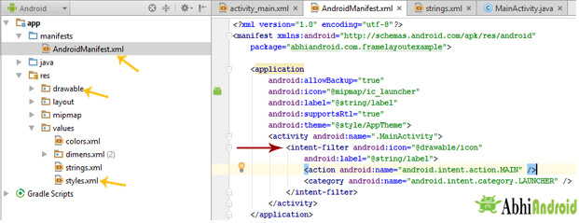
KLE Society’s College of BCA RLSI Belagavi

Slide 16
Syntax of Intent Filters:
Attributes of Intent Filter:
1. android:icon
An icon represents the activity, service or broadcast receiver when a user interact with it or when it appears to user in an application.
android:icon="@drawable/icon
2. android:label
A label represents the title of an activity on the toolbar. You can have different Labels for different Activities as per your requirement or choice.
android:label = "New Activity"
<activity android:name=".MainActivity">
<intent-filter android:icon="@drawable/icon"
android:label="@string/label">
<action android:name="android.intent.action.MAIN" />
<category android:name="android.intent.category.LAUNCHER"/>
<data android:mimeType="text/plain"/>
</intent-filter>
</activity>
KLE Society’s College of BCA RLSI Belagavi

Slide 17
Elements In Intent Filter:
1. Action
It represent an activities action, what an activity is going to do.
An Intent Filter element must contain one or more action element. Action is a string that specifies the action to perform
2. category
It defines the name of an intent category to be accepted and it must be the literal string value of an action
3. data
It defines the type of data to be accepted
<action android:name="android.intent.action.MAIN" />
<category android:name="android.intent.category.LAUNCHER" />
ACTION_MAIN is considered an entry point for the application. Usually, it combines with CATEGORY_LAUNCHER in an <intent-filter> to indicate an activity that should appear in the home screen's launcher
KLE Society’s College of BCA RLSI Belagavi

Slide 18
<!--SEND INTENT FILTER-->
<intent-filter>
<action android:name="android.intent.action.SEND"/>
<category android:name="android.intent.category.DEFAULT"/>
<data android:mimeType="text/plain"/>
</intent-filter>
ACTION_SEND - It’s an activity action that specifies that we are sending some data.
<!--VIEW INTENT FILTER-->
<intent-filter>
<action android:name="android.intent.action.VIEW"/>
<category android:name="android.intent.category.DEFAULT"/>
<category android:name="android.intent.category.BROWSABLE"/>
<data android:scheme="http"/>
action.VIEW-Opens the browser application to the specified address.Opens the browser application to the specified address.
KLE Society’s College of BCA RLSI Belagavi

Slide 19
Broadcast receiver
Broadcast Receivers simply respond to broadcast messages from other applications or from the system itself. These messages are sometime called events or intents.
For example, applications can also initiate broadcasts to let other applications know that some data has been downloaded to the device and is available for them to use, so this is broadcast receiver who will intercept this communication and will initiate appropriate action.
KLE Society’s College of BCA RLSI Belagavi

Slide 20
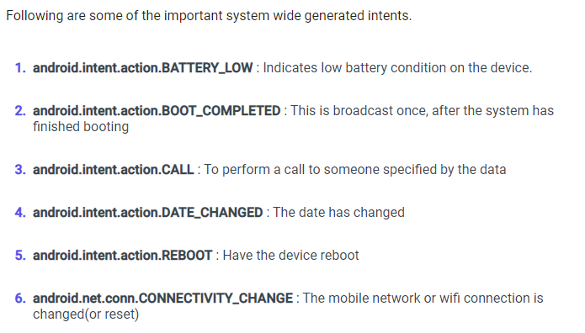
KLE Society’s College of BCA RLSI Belagavi

Slide 21
Android BroadcastReceiver Example
To setup a Broadcast Receiver in our android application we need to do the following things.
Create a BroadcastReceiver
Register a BroadcastReceiver
Now we need to create our own broadcast content file MyBroadcastReceiver.java
public class MyBroadcastReceiver extends BroadcastReceiver {
@Override
public void onReceive(Context context, Intent intent){
CharSequence iData = intent.getCharSequenceExtra("msg");
Toast.makeText(context,"Tutlane Received Message: "+iData,Toast.LENGTH_LONG).show();
}
}
KLE Society’s College of BCA RLSI Belagavi

Slide 22
activity_main.xml
<?xml version="1.0" encoding="utf-8"?>
<LinearLayout xmlns:android="http://schemas.android.com/apk/res/android"
android:orientation="vertical" android:layout_width="match_parent"
android:layout_height="match_parent">
<EditText
android:id="@+id/txtMsg"
android:layout_width="wrap_content"
android:layout_height="wrap_content"
android:layout_marginLeft="100dp"
android:layout_marginTop="180dp"
android:ems="10"/>
<Button
android:id="@+id/btnShow"
android:layout_width="wrap_content"
android:layout_height="wrap_content"
android:onClick="onClickShowBroadcast"
android:layout_marginLeft="130dp"
android:text="Show Broadcast"/>
</LinearLayout>
KLE Society’s College of BCA RLSI Belagavi

Slide 23
public class MainActivity extends AppCompatActivity {
@Override
protected void onCreate(Bundle savedInstanceState) {
super.onCreate(savedInstanceState);
setContentView(R.layout.activity_main);
}
public void onClickShowBroadcast(View view){
EditText st = (EditText)findViewById(R.id.txtMsg);
Intent intent = new Intent();
intent.putExtra("msg",(CharSequence)st.getText().toString());
intent.setAction("com.tutlane.CUSTOM_INTENT");
sendBroadcast(intent);
}
}
KLE Society’s College of BCA RLSI Belagavi

Slide 24
<?xml version="1.0" encoding="utf-8"?>
<manifest xmlns:android="http://schemas.android.com/apk/res/android"
package="com.tutlane.broadcastreceiver">
<application
android:allowBackup="true"
android:icon="@mipmap/ic_launcher"
android:label="@string/app_name"
android:roundIcon="@mipmap/ic_launcher_round"
android:supportsRtl="true"
android:theme="@style/AppTheme">
<activity android:name=".MainActivity">
<intent-filter>
<action android:name="android.intent.action.MAIN" />
<category android:name="android.intent.category.LAUNCHER" />
</intent-filter>
</activity>
<receiver android:name="MyBroadcastReceiver">
<intent-filter>
<action android:name="com.tutlane.CUSTOM_INTENT">
</action>
</intent-filter>
</receiver>
</application>
</manifest>
KLE Society’s College of BCA RLSI Belagavi

Slide 25
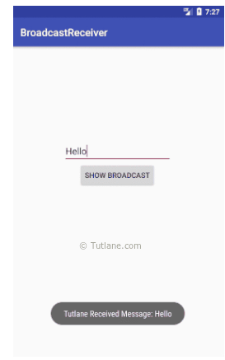
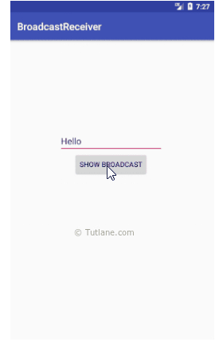
KLE Society’s College of BCA RLSI Belagavi

Slide 26
Android Service
Android service is a component that is used to perform operations on the background such as playing music, handle network transactions, interacting content providers etc. It doesn't has any UI.
Services are used for repetitive and potentially long running operations, i.e., Internet downloads, checking for new data, data processing, updating content providers and the like.
KLE Society’s College of BCA RLSI Belagavi

Slide 27
Android Service Life Cycle
In android, the life cycle of service will follow two different paths Started or Bound.
Started Service
A service is Started when an application component, such as an activity calls startService() method.
Once it started, it will run indefinitely in background even if the component that started is destroyed.
We can stop the Started service by using stopService() method or the service can stop itself by calling stopSelf() method.
In android, the Started service component will perform a single operation and it won’t return any result to the caller.
KLE Society’s College of BCA RLSI Belagavi

Slide 28
Bound Service
A service is Bound when another application component calls bindService() method.
The bound service runs as long as another application component is bound to it.
We can unbind the service by calling unbindService() method based on our requirements.
In android, we can bind multiple components to a single service at once, but the service will be destroyed in case all the components unbind.
KLE Society’s College of BCA RLSI Belagavi

Slide 29
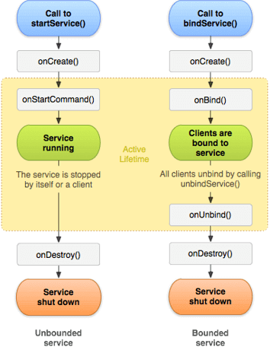
LifeCycle of Service
KLE Society’s College of BCA RLSI Belagavi

Slide 30
To create a service, we need to create a class that extends a Service base class or one of its existing subclasses.
During our service implementation, we must need to override some of the callback methods that handle the key aspects of the service lifecycle and provide the functionality that allows our components to bind to the service.
KLE Society’s College of BCA RLSI Belagavi

Slide 31
Create a Service
Generally, in android to create a service we must create a subclass of Service or use one of existing subclass. In android the application component such as an activity can start the service by calling startService() which results in calling the service’s onStartCommand() method.
Following is the simple example of creating a service in android application.
public class SampleService extends Service {
@Override
public int onStartCommand(Intent intent, int flags, int startId) {
//TODO write your own code
return Service.START_NOT_STICKY;
}
@Override
public IBinder onBind(Intent intent) {
//TODO for communication return IBinder implementation
return null;
} }
KLE Society’s College of BCA RLSI Belagavi

Slide 32
Register a Service in Manifest File
Once we create a service, we need to register that in android manifest file using <service> element like as shown below.
<manifest ... >
...
<application ... >
<service android:name=".SampleService" />
</application>
...
</manifest>
Start a Service
In android, the component such as an activity, service or receiver can start the service using startService() method. Following is the sample code snippet of starting a service using the startService method.
Intent intent = new Intent(this, MyService.class);
startService(intent);
KLE Society’s College of BCA RLSI Belagavi

Slide 33
Android Service Callback Methods
onStartCommand()
The system will invoke this method when another component such as an activity requests the service to be started by calling startService().
When this method executed, the service will start and run indefinitely in background.
If we implement this in our code, it’s our responsibility to stop the service once code execution is done by calling stopSelf() or stopService() methods.
In android, onStartCommand() method must return an integer and the integer is a value that describes how the system will continue the service in the event that the system kills it.
KLE Society’s College of BCA RLSI Belagavi

Slide 34
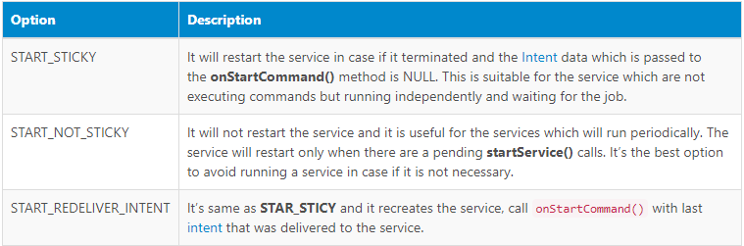
The onStartCommand() method will return a value from one of the following constants.
KLE Society’s College of BCA RLSI Belagavi

Slide 35
onBind()
The system will invoke this method when another component wants to bind with the service by calling bindService().
During implementation of this method, we must need to provide an interface to the clients to communicate with the service by returning an IBinder object.
In android, we must need to implement this method, in case if we don’t need to allow binding, then we should return NULL.
onCreate()
The system will invoke this method when the service is created initially using onStartCommand() or onBind() methods to do one-time setup procedures.
In case, if the service is already running, then this method will not call.
KLE Society’s College of BCA RLSI Belagavi

Slide 36
onDestroy()
The system will invoke this method when the service is no longer used and is being destroyed.
This is the final call that the service will receive and we need to implement this method in our service to clean up any unused resources such as threads, receivers or listeners.
Generally, in android if we start a service by calling startService() method, the service will run continuously even if the component that started service is destroyed until we stop it by using stopService() or it stops itself with stopSelf().
Same way, if we create a service by calling bindService() method, the service will runs as long as the component is bound to it. After the service is unbound from all of its clients, the system will destroy it.
KLE Society’s College of BCA RLSI Belagavi

Slide 37
Android Services Example
Following is the example of start playing music in the background when we start a service and that music will play continuously until we stop the service in the android application.
public class MyService extends Service {
private MediaPlayer player;
public IBinder onBind(Intent intent) {
return null;
}
public void onCreate() {
Toast.makeText(this, "Service was Created", Toast.LENGTH_LONG).show();
}
public int onStartCommand(Intent intent, int flags, int startId) {
player = MediaPlayer.create(this, Settings.System.DEFAULT_RINGTONE_URI);
// This will play the ringtone continuously until we stop the service.
player.setLooping(true);
// It will start the player
player.start();
Toast.makeText(this, "Service Started", Toast.LENGTH_LONG).show();
return START_STICKY;
}
@Override
public void onDestroy() {
super.onDestroy();
// Stopping the player when service is destroyed
player.stop();
Toast.makeText(this, "Service Stopped", Toast.LENGTH_LONG).show();
}
}
KLE Society’s College of BCA RLSI Belagavi

Slide 38
Activity_main.xml
<?xml version="1.0" encoding="utf-8"?>
<LinearLayout xmlns:android="http://schemas.android.com/apk/res/android"
android:orientation="vertical" android:layout_width="match_parent"
android:layout_height="match_parent">
<Button
android:id="@+id/btnStart"
android:layout_width="wrap_content"
android:layout_height="wrap_content"
android:onClick="startService"
android:layout_marginLeft="130dp"
android:layout_marginTop="150dp"
android:text="Start Service"/>
<Button
android:id="@+id/btnstop"
android:layout_width="wrap_content"
android:layout_height="wrap_content"
android:onClick="stopService"
android:layout_marginLeft="130dp"
android:layout_marginTop="20dp"
android:text="Stop Service"/>
</LinearLayout>
KLE Society’s College of BCA RLSI Belagavi

Slide 39
public class MainActivity extends AppCompatActivity {
@Override
protected void onCreate(Bundle savedInstanceState) {
super.onCreate(savedInstanceState);
setContentView(R.layout.activity_main);
}
// Start the service
public void startService(View view) {
startService(new Intent(this, MyService.class));
}
// Stop the service
public void stopService(View view) {
stopService(new Intent(this, MyService.class));
}
}
KLE Society’s College of BCA RLSI Belagavi

Slide 40
AndroidManifest.xml
<?xml version="1.0" encoding="utf-8"?>
<manifest xmlns:android="http://schemas.android.com/apk/res/android"
package="com.tutlane.services">
<application
android:allowBackup="true"
android:icon="@mipmap/ic_launcher"
android:label="@string/app_name"
android:roundIcon="@mipmap/ic_launcher_round"
android:supportsRtl="true"
android:theme="@style/AppTheme">
<activity android:name=".MainActivity">
<intent-filter>
<action android:name="android.intent.action.MAIN" />
<category android:name="android.intent.category.LAUNCHER" />
</intent-filter>
</activity>
<service android:name=".MyService" />
</application>
</manifest>
KLE Society’s College of BCA RLSI Belagavi

Slide 41
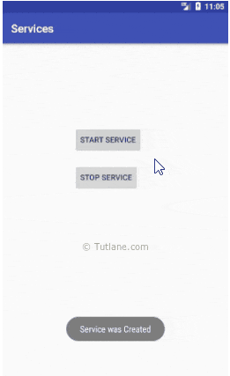
OUTPUT:
KLE Society’s College of BCA RLSI Belagavi

Slide 42
Multithreading
Multi-threading is defined as a feature through which we can run two or more concurrent threads of a process. In this process, the common data is shared among all these threads also known as sub-processes exclusively.
Multi-Threading In Android:
Multi-Threading in Android is a unique feature through which more than one threads execute together without hindering the execution of
other threads.
Multi-Threading in Android is not different from conventional multi-Threading. A class can be thought of as a process having its method as it’s sub-processes or threads. All these methods can run concurrently by using feature of Multi-Threading.
In android, multithreading can be achieved through the use of many in-built classes. Out of them, Handler class is most commonly used.
KLE Society’s College of BCA RLSI Belagavi

Slide 43
Handler class in Android:
Handler class come from the Package android.os.Handler package and is most commonly used for multi-threading in android. Handler class provide sending and receiving feature for messages between different threads and handle the thread execution which is associated with that instance of Handler class.
In android class, every thread is associated with an instance of Handler class and it allows the thread to run along with other threads and communicate with them through messages.
Instantiating Handler class:
There are following two ways in which Handler class is usually instantiated for supporting multi-threading:
Through default constructor.
Handler handlerObject = new Handler();
Through Parameterized constructor
Handler handleObject = new Handler(Runnable runnableObject, Handler.Callback callbackObject);
KLE Society’s College of BCA RLSI Belagavi

Slide 44
Methods of Handler class for Multi-Threading:
Public final Boolean post(Runnable runnableObject)
{
return booleanValue;
}
This Method attach a runnable instance with it’s associated thread and the body of that runnable instance will execute every time the thread gets executed.
Public final Boolean postAtTime((Runnable runnableObject, long
timeinMillisecondObject)
{
return booleanValue;
}
This Method attach a runnable instance with it’s associated thread and the body of that runnable instance will execute every time the thread gets executed at a time specified by the second argument.
KLE Society’s College of BCA RLSI Belagavi

Slide 45
Public final Boolean postDelayed((Runnable runnableObject, long
timeinMillisecondObject)
{
return booleanValue;
}
This Method attach a runnable instance with its associated thread and the body of that runnable instance will execute every time the thread gets executed after a time specified by the second argument.
KLE Society’s College of BCA RLSI Belagavi

Slide 46
Runnable Interface:
This runable interface is used by the Handler class to execute the multi-threading, i.e., to execute one or more thread in specified time.
Runnable is an interface which is implemented by the class desired to support multithreading and that class must implements it’s abstract method public void run().
Run() method is the core of multithreading as it includes the statement or calls to other methods that the thread needs to be made for multithreading.
class ClassName implements Runnable
{
@override
Public void run()
{
Body of method
}
}
KLE Society’s College of BCA RLSI Belagavi

